Slide 1
Date: 6th Feb'2023 SENSORS and ACTUATORS
Narsaiah Putta
Asst. Professor
Dept. of CSE
VCE.

Slide 2
CONTENTS
• Introduction
•
Architecture
• Class of sensors
• Types of sensors
• Examples
• Applications

Slide 3
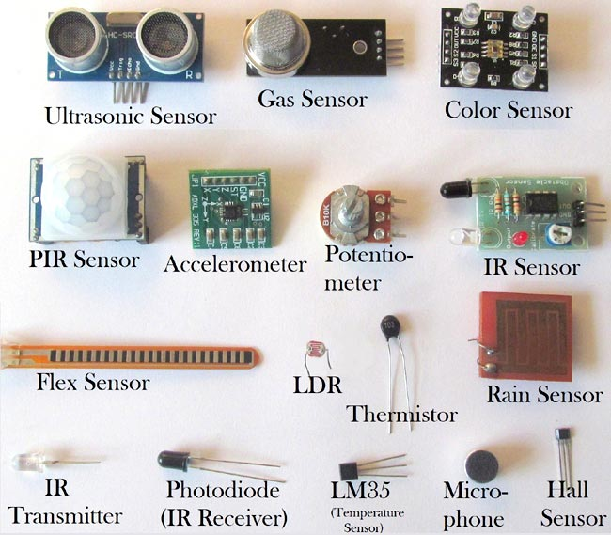
INTRODUCTION
A sensor is a device, module, machine, or subsystem whose purpose is to detect events or changes in its environment and send the information to other electronics devices, frequently a computer processor.
Examples:
4

Slide 4
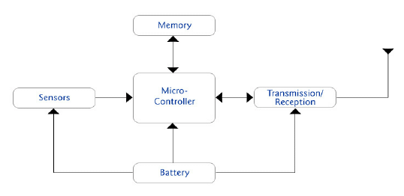
Sensor Architecture

Slide 5
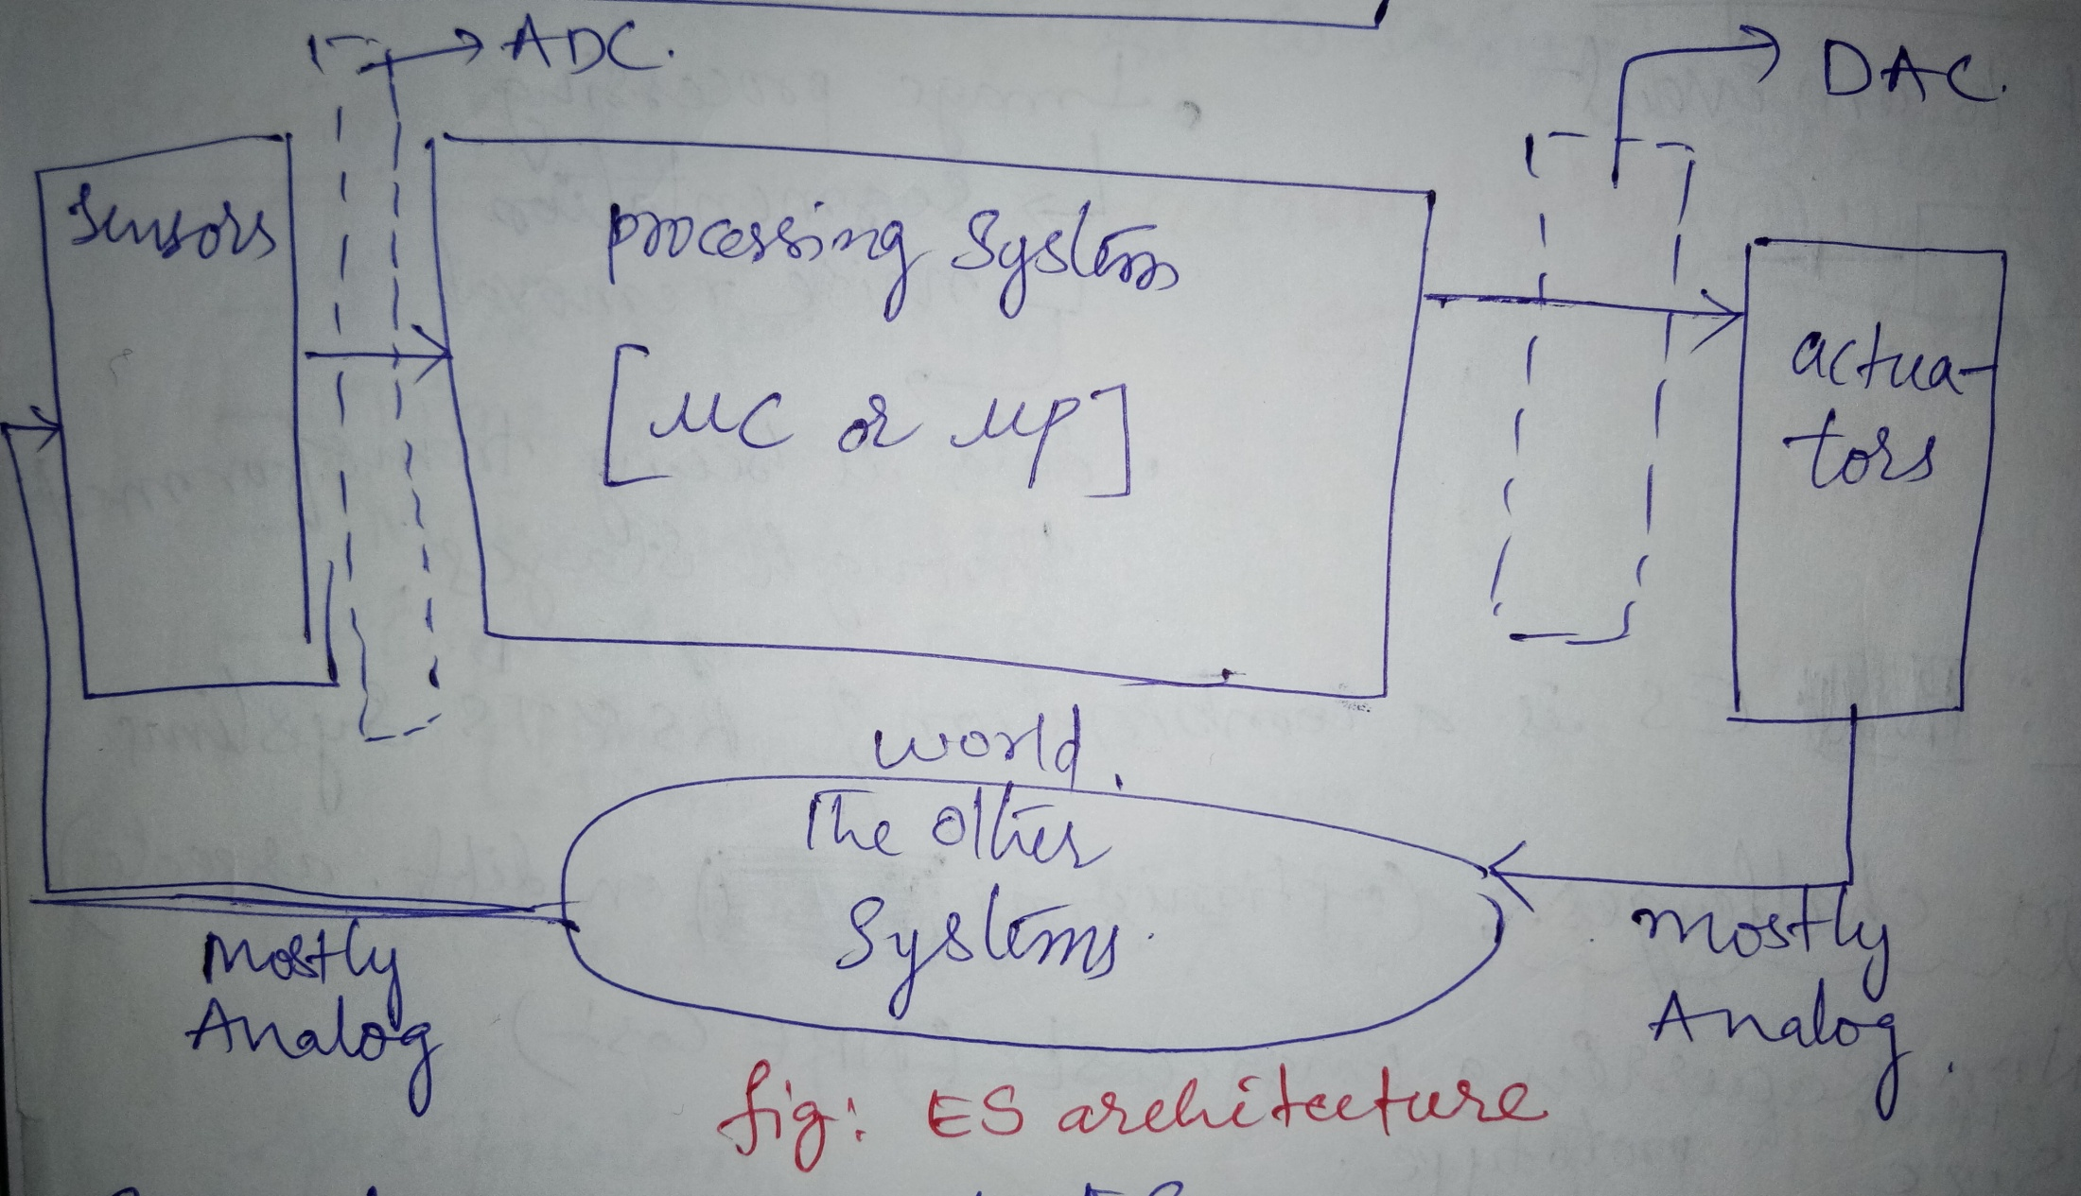
The Sensor in Embedded System
Digital
Data
Analog
Data

Slide 6
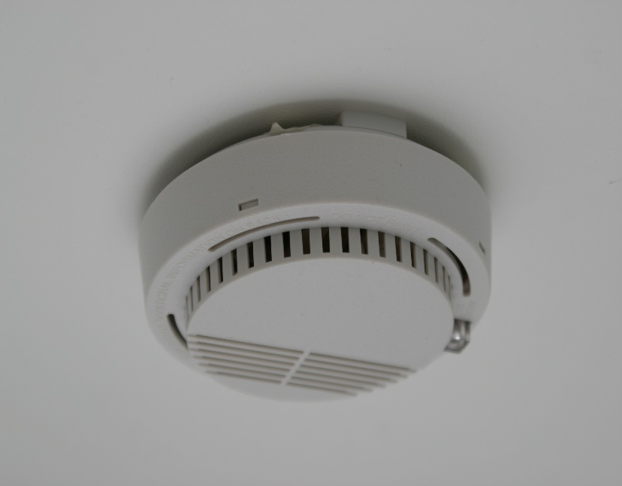
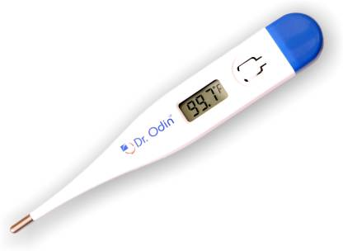
Class of Sensors
Active Sensors
Requires an external source of power to operate.
Simply detect and respond to some type of input from the
physical environment.
Eg: Smoke Sensor
Passive Sensors
Does not requires an external source of power to operate
Simply detect and respond to physical environment
Eg: Thermometer

Slide 7
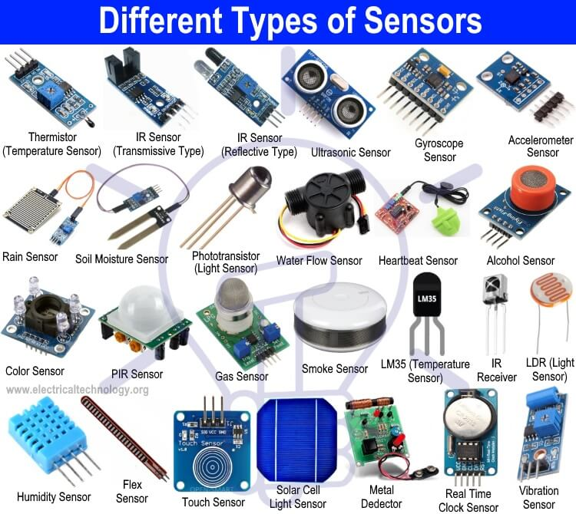

Slide 8
Applications
To measure / find
the Temperature .
The distance
The Pressure
The humidity
The Smoke, Gas and Alcohol Sensor.
The color of an object
Detect objects
Soil moisture
etc…..

Slide 9

QUESTIONS
Minimum 7 or 8 hours of sleep is required for adults

